Slide 1
Dr.SNS RAJALAKSHMI COLLEGE OF ARTS AND SCIENCE (AUTONOMOUS) COIMBATORE-641049 Accredited by NAAC(Cycle III) with “A+” Grade Recognised by UGC, Approved by AICTE, New Delhi and Affiliated to Bharathiar University, Coimbatore.
DEPARTMENT OF COMPUTER SCIENCE
18UCS810: MOBILE APPLICATION DEVELOPMENT(Blended)
III YEAR - V SEM
UNIT 4– E-COMMERCE MOBILE APP
TOPIC – E-COMMERCE MOBILE APP DEVELOPMENT

Slide 2
OUTLINE
Ecommerce
Why E-Commerce?
Important Factors that govern Ecommerce
Features of Ecommerce
Upcoming Trends

Slide 3
E-Commerce
E-commerce is a transaction of buying or selling online. Electronic commerce draws on technologies such as mobile commerce, electronic funds transfer, supply chain management, Internet marketing, online transaction processing, electronic data interchange (EDI).

Slide 4
Why E-Commerce?
3 key reasons why your business needs an e-commerce mobile application
Engage your audience faster
Achieve greater brand loyalty
Easier to personalize for better outcomes

Slide 5
Engage your audience faster
Possibly the greatest advantage of building your own e-commerce mobile app is the sheer speed and ease of connecting to your buyers in real time.

Slide 6
Achieve greater brand loyalty
You can also ensure the app’s look and feel contribute to brand building and marketing of your business and aim at brand stickiness to ensure customer loyalty.
Ideas like these are a great way to increase customer retention and contain churn. While you keep updating the e-commerce mobile app with new features, the user base will gradually expand, even as existing customers keep visiting to find out what’s new and on discount.

Slide 7
Easier to personalize for better outcomes
SNS DESIGN THINKERS/ Dr.SNSRCAS / CS / 18UCS810-Mobile Application Development/UNIT-3/ Ms R.SARANYA

Slide 8
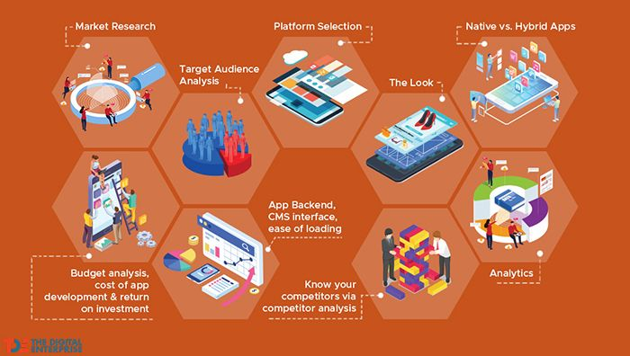
I Factors that Govern Your E-commerce Mobile App Development

Slide 9
Contd…
1. Market Research
The first step is to accurately and objectively assess how viable it is for your business to venture into building its e-commerce presence at a particular point in time.
2. Target Audience Analysis
After you have clearly defined the current business scenario and future needs, it’s time to conduct a thorough audience analysis.
3. Platform Selection
Your mobile e-commerce app needs to initially focus on either Android or iOS app development based on the market research and audience analysis, which will throw up data on where majority of your users are present.

Slide 10
Contd..
4. The Look
When it comes to building a mobile e-commerce app, User Interface (UI) and User Experience (UX) lead to success. So, do put a lot of thought into the color schemes, transitions, and visuals that customers are known to appreciate and ensure your mobile e-commerce app allows them to move effortlessly from one section to another.
5. Native versus Hybrid Apps
A native mobile app is an application that is created for use on a specific platform or device, like Android, iOS, or Windows, as it is customized and coded in its native programming language.

Slide 11
contd…
6.Budget Analysis
While it’s important to factor in the cost of developing your business e-commerce app, it’s equally critical to chalk out the expected ROI and cost-benefit analysis to get an overall picture of taking up this project.
7. ease of loading
The foundation of every successful mobile e-commerce app is an app back end for sharing and processing data from multiple users and storing large databases to process on demand. For e-commerce apps on managed platforms, the upgrades, scalability and other.

Slide 12
Contd….
8.Competitor Analysis
When developing your mobile e-commerce app, analyze what has worked for your competitors. If their mobile consumers are leaving positive reviews, learn from their feedback and incorporate these into your own build.
9. Business Analysis
Other than competitor analysis, it’s also critical to derive actionable insights from the analysis of your own business operations till date

Slide 13
features for any mobile e-commerce application
Easy registration
Search and filter
Cart and wish list
Checkout and payment
Order tracking

Slide 14
Estimating costs and efforts for e-commerce mobile application development
Cost estimates of your mobile e-commerce app development depends on the features you plan to incorporate

Slide 15
Contd…
Cart: This includes various payment systems integrations, taking anywhere between 70 and 110 hours to develop.
User Account: With the shoppers’ individual data, profile image, and order histories, this need 35 to 50 hours.
Main Screen: For searching and filtering products across multiple catalogs, this takes 30 to 45 hours.
Product Details Screen: With photo sliders, ratings, and reviews as well as ‘share’ plug-ins across social networks, this comes in at 20 to 40 hours.

Slide 16
Upcoming Trends in E-commerce App Development
Geo fencing
Direct image and voice-based search
Internet of Things
AI-powered assistants

